Slide 1
WELCOME EVERYONE
SOCIAL SCIENCE
SOCIAL SCIENCE

Slide 2
INSTRUCTIONS TO STUDENTS
DRESS PROPERLY
ALWAYS KEEP THE MICROPHONE ONAND CAMERA UNMUTED
ARRANGE A COMPATIBLE INTERNET CONNECTIVITY
KEEP ALL THE ITEMS LIKE TEXTBOOK ,PEN READY
ENTER THE CLASSROOM IN TIME
PROMPTLY RETURN AFTER BREAKS
USE CHAT BOX FOR RESPONSES
QUIT IMMEDIATELY AFTER THE SESSION
PARENTS TO REMAIN PASSIVE OBSERVERS

Slide 3
ABOUT SOCIAL SCIENCE
WHY DO WE STUDY SOCIAL SCIENCE?
WHAT DO YOU KNOW ABOUT PAST?
WHY STUDY HISTORY?

Slide 4
SOCIAL SCIENCE
How do we study social science?
How To Do It?
Give your whole attention to your study. Find a quiet spot to work. ...
Organize what you need to learn. Think about your subject. ...
Make sense of what you know. Now think about the information you have organized. ...
Rehearse what you know. Now that you understand the subject, you'll need to remember it.

Slide 5
WHY DO WE STUDY SOCIAL SCIENCE
It is important to study social sciences because they are about what it
means to be human. When we better understand ourselves, we can
better understand how the world works. Once we understand that, we are able to identify root causes of society's problems and find more effective solutions.

Slide 6
HISTORY

Slide 7
DEFINE HISTORY

Slide 9
FRAMES OF HISTORY
PREHISTORY –NO WRITTEN RECORDS
PROTOHISTORY – WRITTEN RECORDS
HISTORY- INVENTION OF WRITING

Slide 10
CALENDARS/DATES IN HISTORY

Slide 11
GEOGRAPHICAL FRAMEWORK
IMPORTANT ROLE IN THE HISTORY OF INDIA
HIMALAYAS- NATURAL BARRIER
INDUS AND GANGA ARE FERTILE REGIONS
RIVER VALLEYS WERE PEOPLE SETTLED FIRST
PEOPLE GROW CROPS EASILY
DETERMINES THE DEVELOPMENT OF AREA.

Slide 12
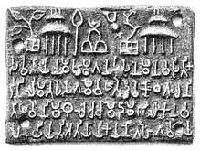
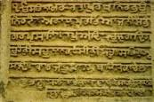
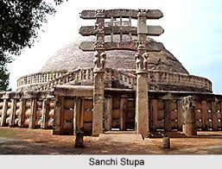
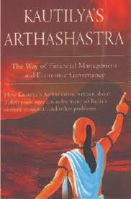
SOURCES OF HISTORY
ARCHAEOLOGICAL
LITERARY

Slide 13
ARCHAEOLOGICAL SOURCES
INSCRIPTIONS
MONUMENTS
ARTEFACTS
COINS

Slide 14
LITERARY SOURCES
RELIGIOUS LITERATURE
SECULAR LITERATURE

Slide 15
SOURCES OF HISTORY
coins
Not included

Slide 16
RECAPITULATION

Slide 18
CASE/ PROBLEM / EVENT/ BRAINSTORMING RELATED TO THE CONCEPT

